Slide 1
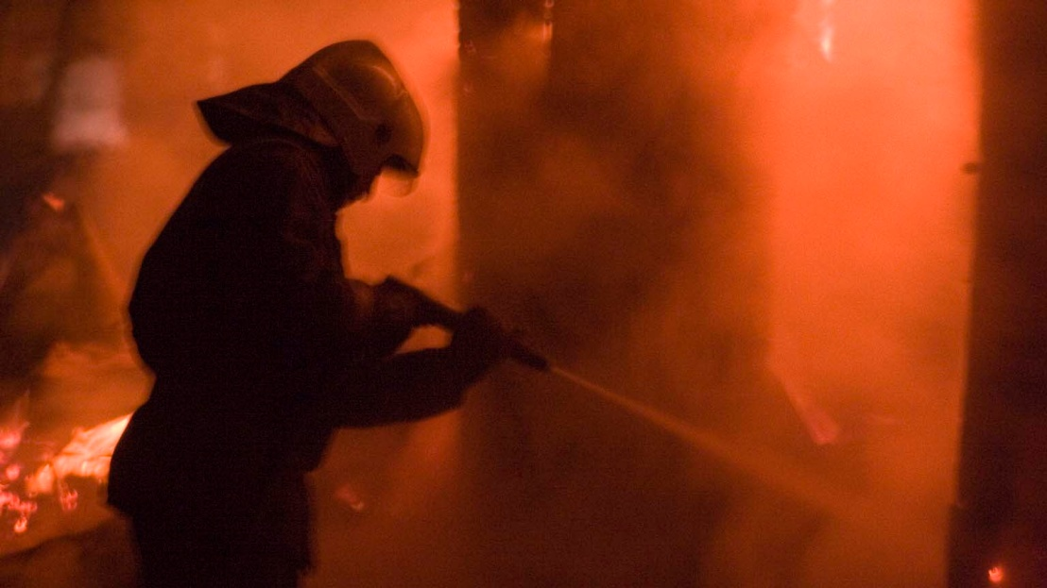

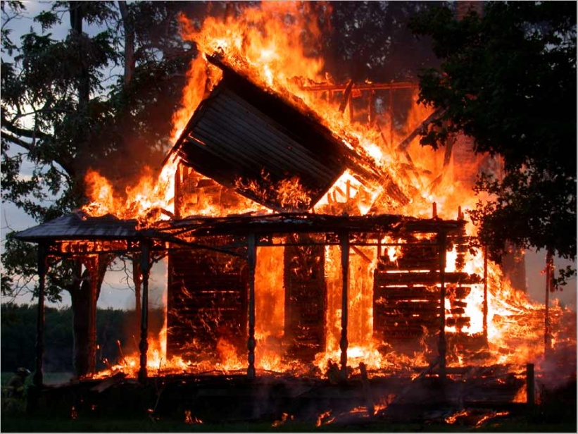
Acс__den_

Slide 2
Accident

Slide 3
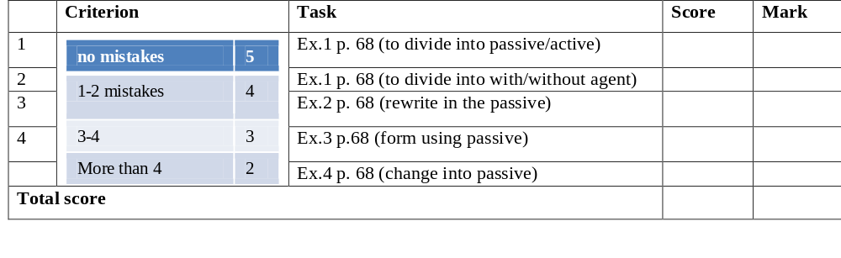

Slide 4
Got acquainted with …
Found out…
Learnt…
Remembered…
Review the material about…
Done…
Read…
Written…

